Slide 1
Unconstrained Optimization
Ayush Kumar Shah
Murtaza Tamjeed

Slide 2
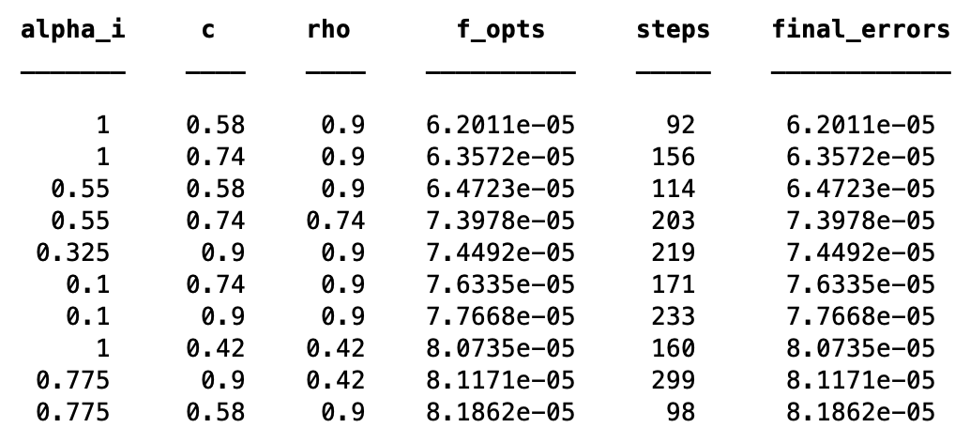
Function One
Gradient Descent method

Slide 3
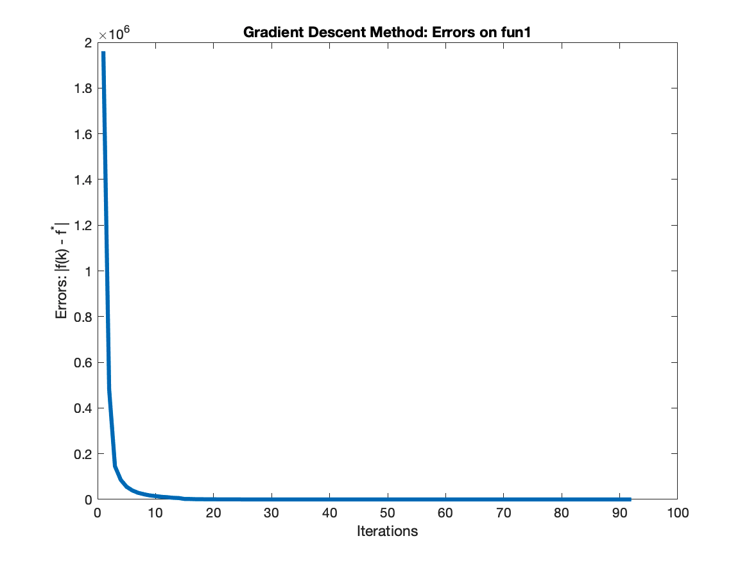
Function One
Gradient Descent method
Best parameters:
alpha_i = 1.000000 c = 0.580000 rho = 0.900000
Best results:
f_opt = 0.000062
steps=92
final error=0.000062
total time=0.022105 sec
time per iteration=0.000240 sec

Slide 4
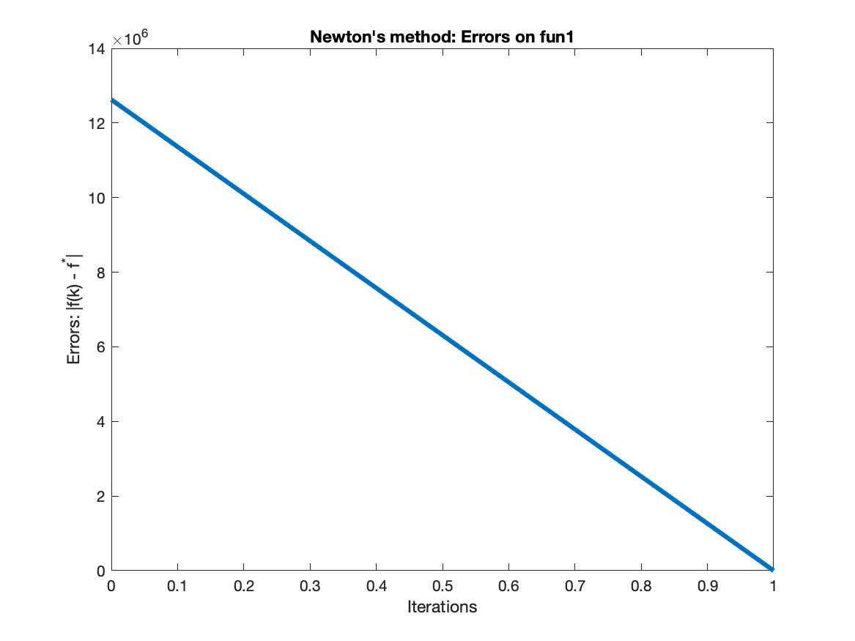
Function One
Newton method
Parameters:
alpha_i = 1.000000 c = 0.100000 rho = 0.500000
Results:
f_opt = 0.000000
Steps = 1
Final error = 0.000000
Total time = 0.001410 sec
Time per iteration = 0.001410 sec

Slide 5
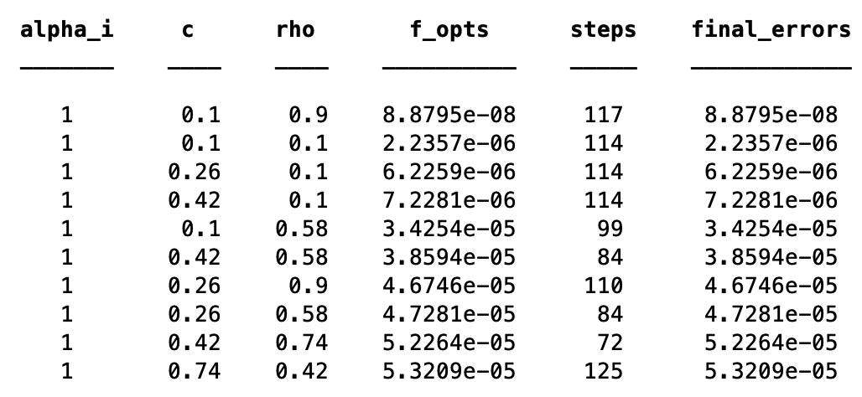
Function One
Quasi-Newton method

Slide 6
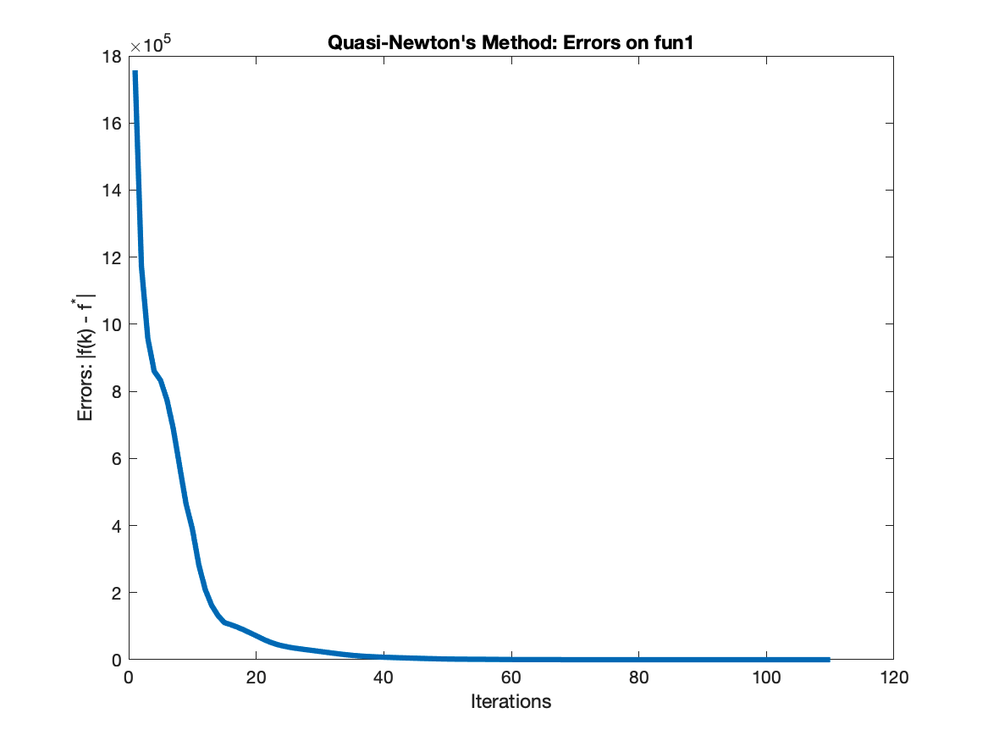
Function One
Quasi-Newton method
Best Parameters:
alpha_i = 1.000000 c=0.100000 rho=0.900000
Best Results:
f_opt = 0.000000
steps = 117
final error = 0.000000
total time = 0.048935 sec
time per iteration = 0.000418 sec

Slide 7
Comparison and Analysis: Function 1
The given function is quadratic in nature with global optimum given as (f(x)_{min} = 0).
Using a lower value of alpha requires more steps to converge and the value of 1 is generally better.
Results are generally good when c is set to a low value like 0.1 and becomes worse for larger values of c.
Newton's method reached the global minimum in a single iteration since the input function is a quadratic function.
Notes:
since the larger value of c may not find satisfactory step size (alpha). Best

Slide 8
Comparison and Analysis: Function 1
Quasi-Newton’s method took the longest time to converge while Newton’s method the least.
Time per iteration was the least for gradient descent and highest for Newton's method.
The gradient descent method was able to obtain functional value very close to the global minimum but not the exact value.
Newton's method and Quasi-Newton’s method were able to converge to the global minimum.
Notes:
since the larger value of c may not find satisfactory step size (alpha). Best

Slide 9
Function Two
Domain Restriction
Function two in the project is a large dimensional function with logarithms.
Domain for the input (x) is restricted by b_{i} - a_{i}^{T} x >= 0 to avoid logarithm of a negative number.
Initial value of x chosen such that it is inside the domain.
Backtracking line search algorithm updated to select step-size (alpha) such that
x + alpha * p falls in the given domain satisfied by the above constraint.

Slide 10
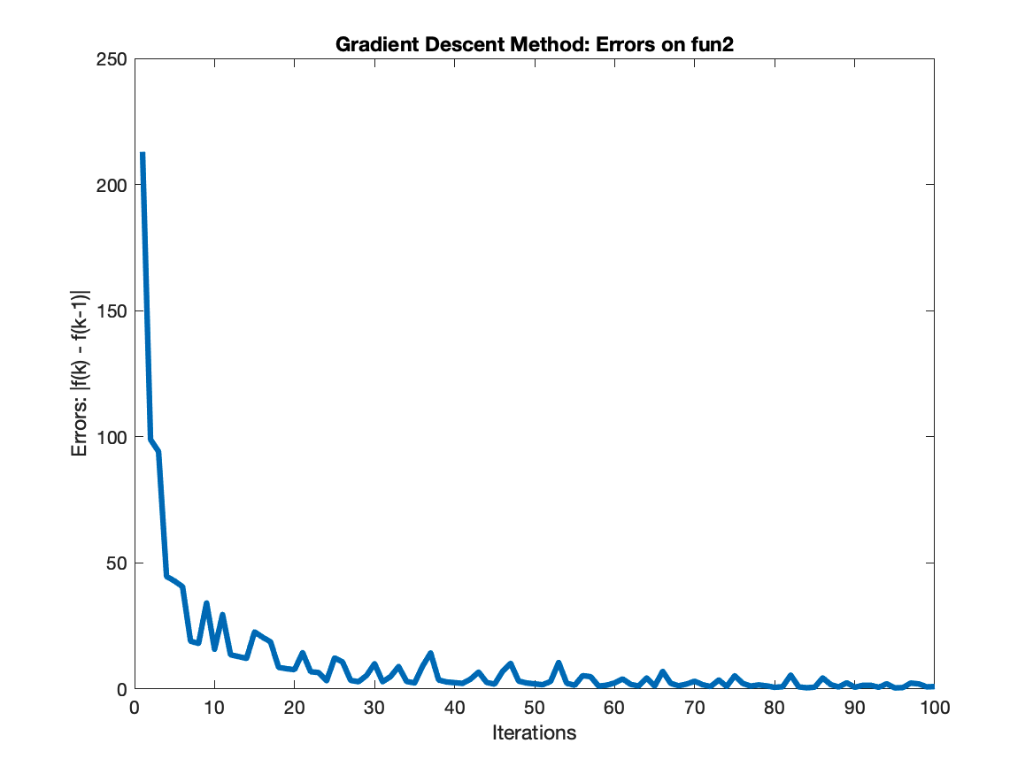
Function Two
Gradient Descent method
Parameters:
alpha_i = 1.000000 c=0.100000 rho=0.500000
Results:
f_opt = -2440.219455
Steps = 300
Final error = 0.012804
Total time = 301.782423 sec
Time per iteration = 1.005941 sec

Slide 11
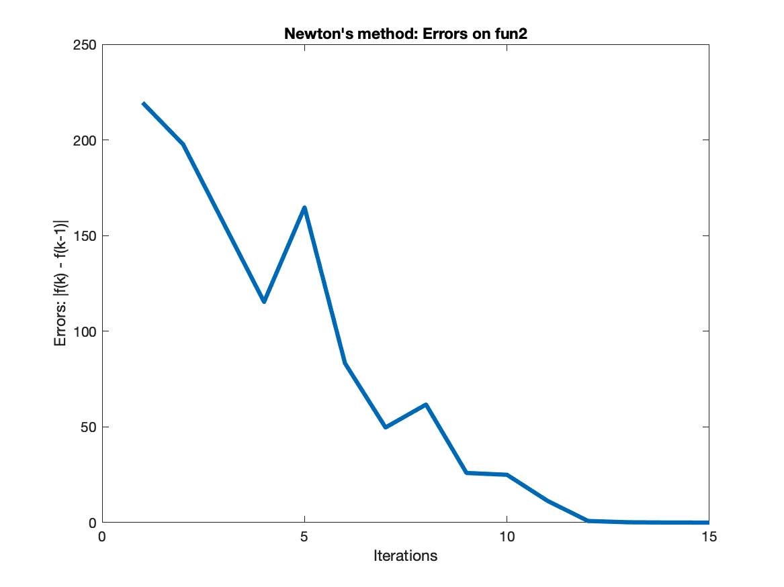
Function Two
Newton method
Parameters:
alpha_i = 1.00000 c = 0.100000 rho = 0.500000
Results:
f_opt = -2443.244762
Steps = 15
Final error = 0.008915
Total time = 6.212515 sec
Time per iteration = 0.414168 sec

Slide 12
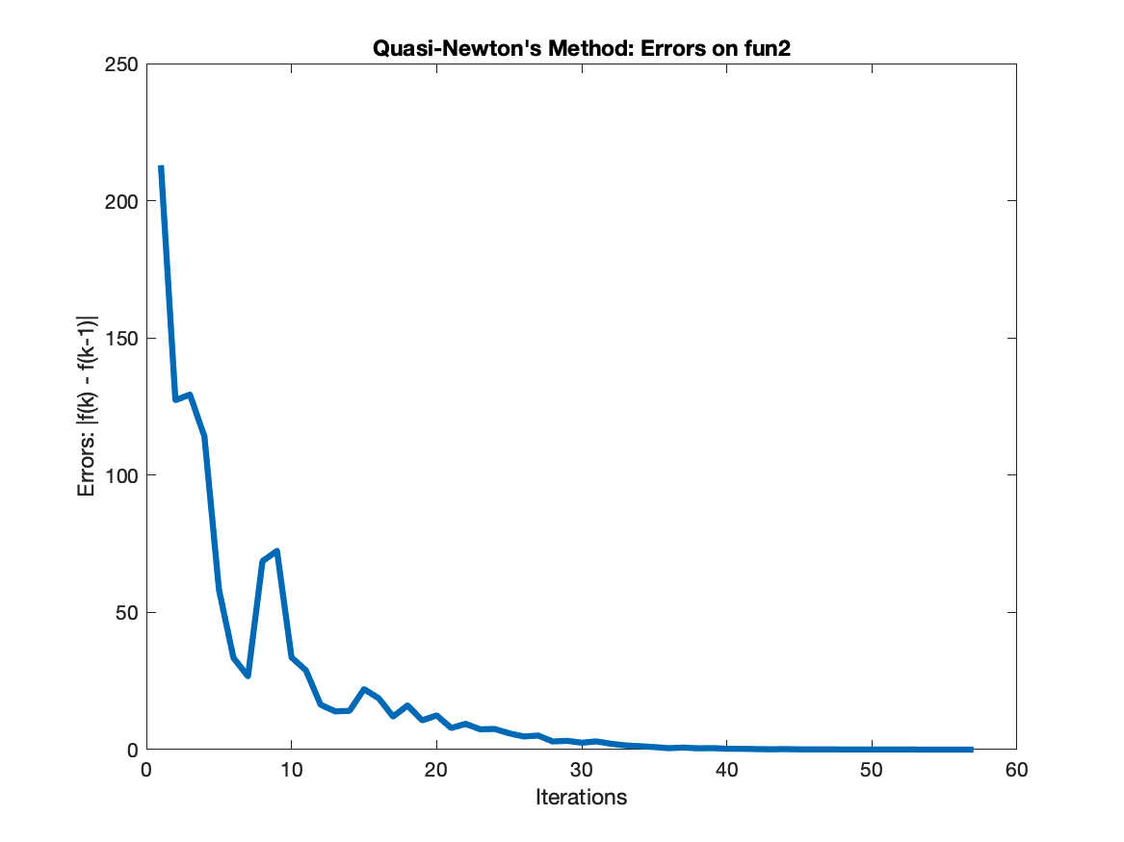
Function Two
Quasi-Newton method
Parameters:
alpha_i = 1.000000 c=0.100000 rho=0.500000
Results:
f_opt = -2443.207609
Steps = 57
Final error=0.008309
Total time=43.474292 sec
Time per iteration=0.762707 sec

Slide 13
Comparison and Analysis: Function 2
Gradient Descent is not reliable for a complex and large dimensional function.
Gradient Descent could not converge by satisfying the stopping condition due to
the complex nature and large dimension of function 2.
Slow rate of convergence (linear).

Slide 14
Comparison and Analysis: Function 2
Newton’s method could converge very quickly in 15 steps, and Quasi-Newton in 57 steps
due to the faster convergence rate (quadratic and super linear respectively)
Functional values obtained by all three algorithms are very close to each other.

Slide 15
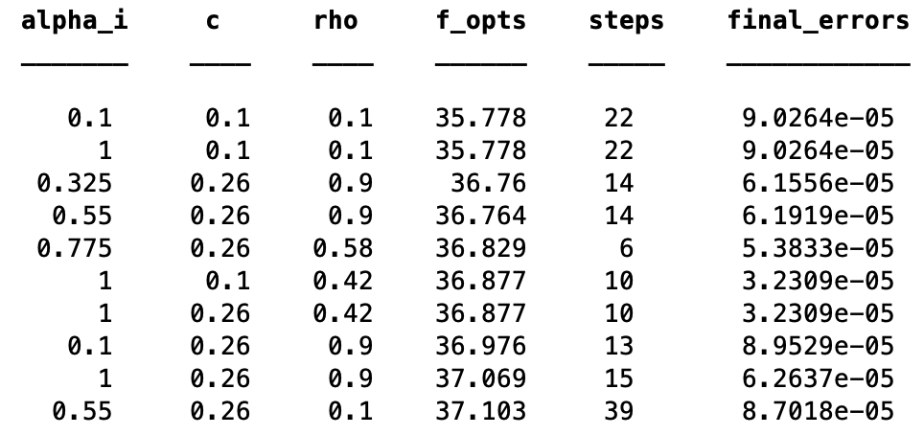
Function Three
Gradient Descent method

Slide 16
Function Three
Gradient Descent method
Best parameters:
alpha_i = 0.100000 c = 0.100000 rho=0.100000
Best results:
x_min = [6.9814 ; 48.7434]
f_opt = 35.778311
Steps = 22
Final error = 0.000090
Total time = 0.004341 sec
Time per iteration = 0.000197 sec

Slide 17
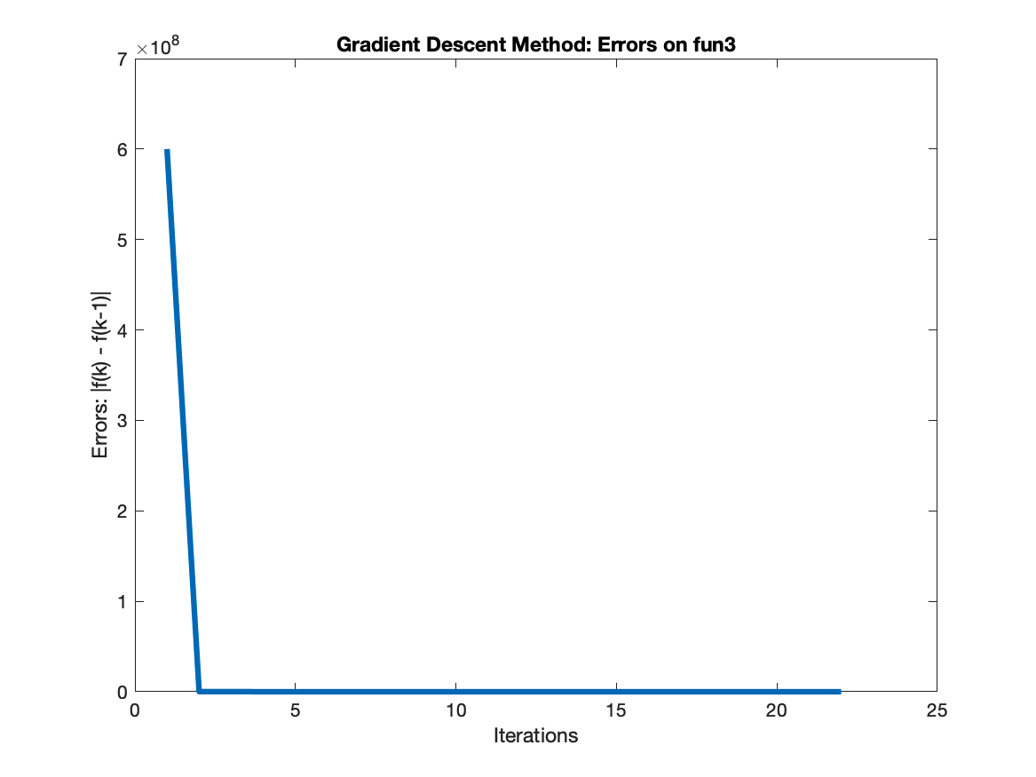
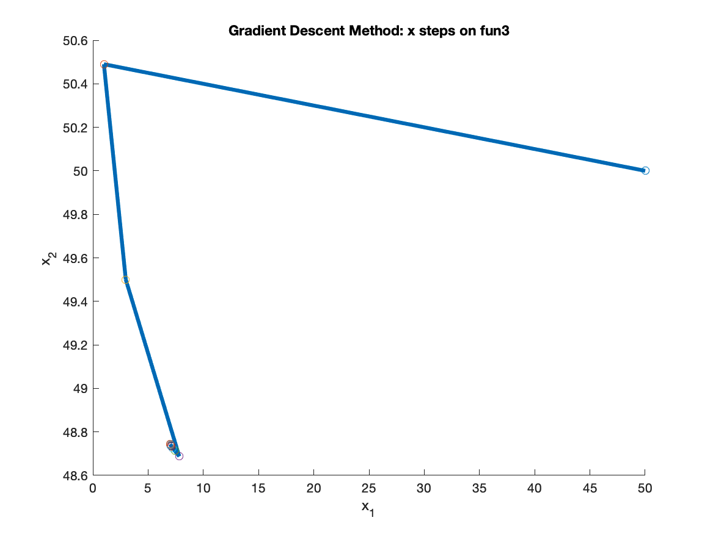
Function Three
Gradient Descent method

Slide 18
Function Three
Newton method
Parameters:
alpha_i = 1.000000 c = 0.100000 rho=0.500000
Results:
x_min = [1.0001; 1.0001]
f_opt = 0.000000
Steps = 130
Final error = 0.000011
Total time = 0.017100 sec
Time per iteration = 0.000132 sec

Slide 19
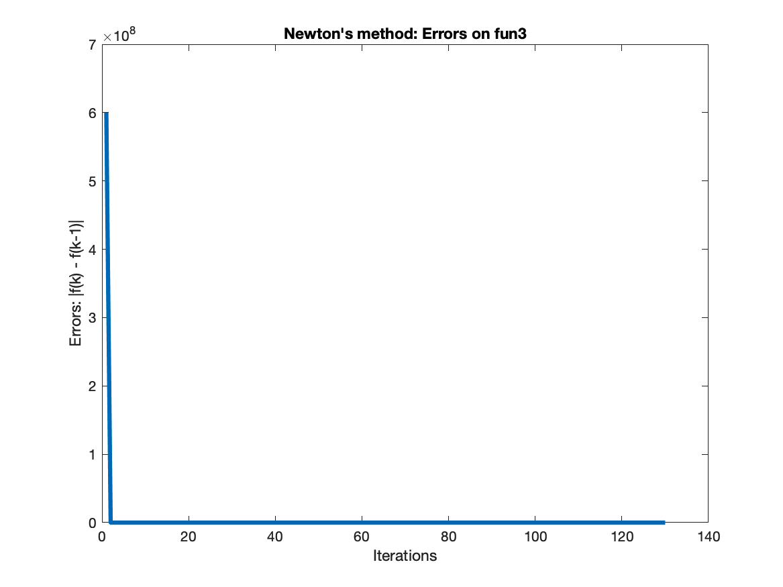
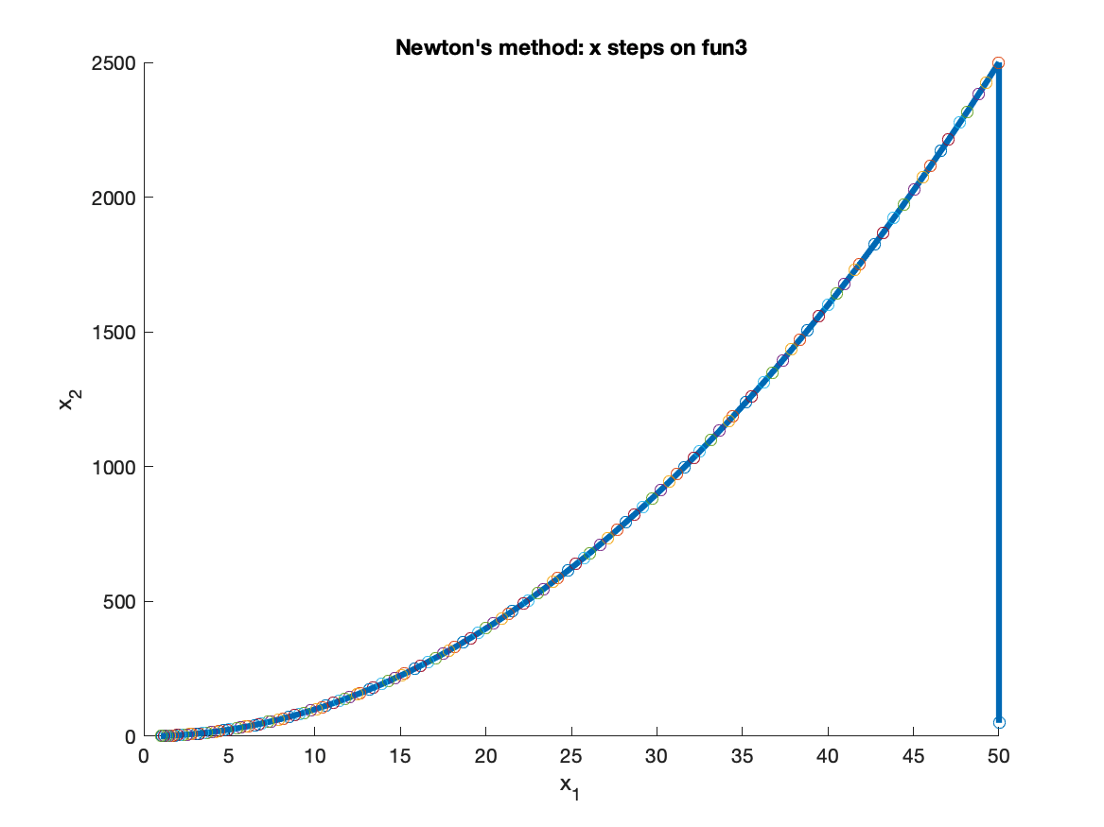
Function Three
Newton method

Slide 20
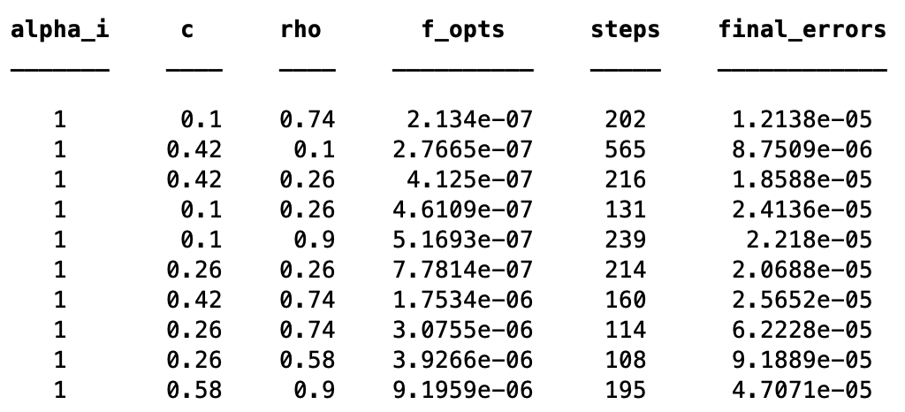
Function Three
Quasi-Newton method

Slide 21
Function Three
Quasi-Newton method
Best Parameters:
alpha_i = 1.000000 c = 0.100000 rho = 0.740000
Best Results:
x_min = [0.9995;0.9991]
f_opt = 0.000000
Steps = 202
Final error = 0.000012
Total time = 0.021020 sec
Time per iteration = 0.000104 sec

Slide 22
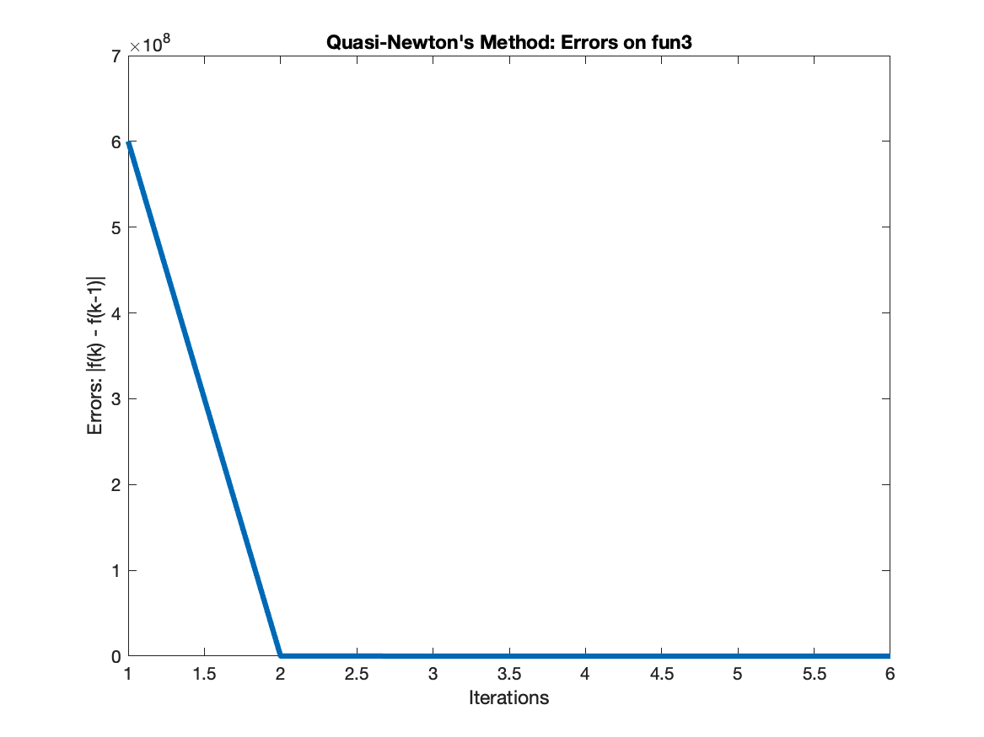
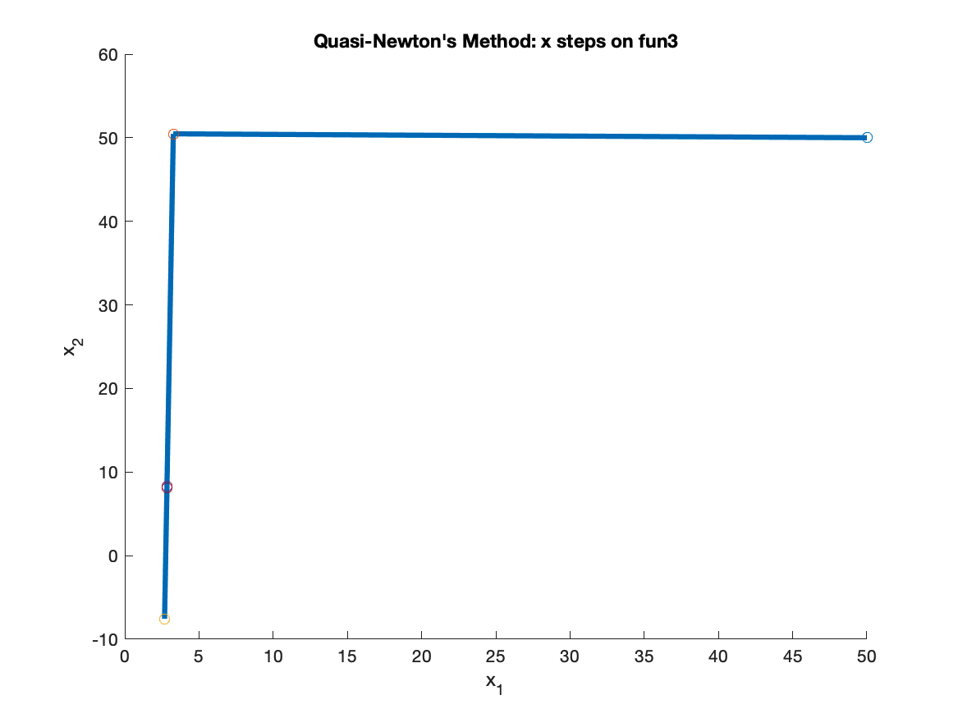
Function Three
Quasi-Newton method

Slide 23
Comparison and Analysis: Function 3
Function three in the project is a polynomial function of order 4.
Lower value of alpha requires more steps to converge and the value of 0.1 is generally better.
The optimization results are generally good when c is set to a low value like 0.1 and the results deviate from the global minimum for larger values of c.
since the larger value of c may not find satisfactory step size (alpha).
The gradient descent method does not reach a global minimum (f(x)_{min} = 0).

Slide 24
Comparison and Analysis: Function 3
Gradient descent method gets stuck in a local minimum (very far from the global minimum) since it satisfies the stopping criteria in just 22 steps.
Both Newton’s method and Quasi_newton’s method were successful to converge very close to a global optimum (f(x)_{min} = 0).
The time per iteration was the least for Quasi_newton’s method and the highest for the Gradient Descent method.

Slide 25
Discussion and Conclusion
Overall, Newton's method performs well since it generally takes less time to converge.
Newton’s method is best for quadratic functions since it converges in a single iteration.
The gradient descent method is not reliable, especially for complex and high dimensional functions since
It takes a very long time to converge.
It may get stuck at local minima.
does not require Hessian and involves fewer computations at each iteration.

Slide 26
Discussion and Conclusion
The Quasi-Newton’s performance (both time and accuracy) is generally in between Gradient and Newton’s methods.
The time taken is dependent on the rate of convergence of errors:
Gradient descent: linear rate
Newton’s method: quadratic rate
Quasi-Newton: superlinear rate

Slide 27
QUESTIONS?

Slide 28
Team Contributions
We did most of the work together during our scheduled meetings. We implemented most of the algorithms during the breakout room sessions in the past two weeks as part of our class activities. We also met right after the classes trying to improve our code. More specifically for the project, Ayush took care of writing the functions, gradients, and Hessians for functions 1 and 2, improving our code related to functions 1 and 2 of the project, with the implementation of domain restriction for function 2 and grid search for selecting the best parameters; and Murtaza took care of writing the function, gradient and Hessian of function 3 and improving the code related to function 3. Also, Murtaza wrote a first draft of the project report and the presentation. Then, both Ayush and Murtaza worked together to improve them during multiple meetings.

